Slide 1



  G H RAISONI SKILLTECH UNIVERSITY, NAGPUR
  DEPARTMENT OF SCIENCE & TECHNOLOGY
(Bachelor of Computer Application)
Project Progress Seminar -I
On
Smart HR-Analytics Dashboard System With AI Assistant
Guide:
Ritesh Madankar , Rohit Mohurle
BCA Student
Name of Projectees
#1 Prajwal Chahande #2 Rohit Gupta
#3 Ritesh Madankar #4 Purvesh Deshmukh
#5 Rohit Mohurle #6 Aryan Bhoyar
Session 2026
Nagpur | Pune | Jalgaon | Amravati | Pandhurna | Bhandara

Slide 2
Contents
Introduction
Literature Survey
Problem Statement
Justifications for Selecting the Title
Objectives of the Project
Block Diagram
Expected Result
Work plan
References

Slide 3
Introduction
“Our project is Smart HR-Analytics Dashboard System with AI Assistant.
Companies have a large amount of employee data, which is difficult to analyze manually.
Our system uses Excel,and Power BI to analyze employee data and create an interactive dashboard.
The AI Assistant helps HR teams ask questions about the data and get quick answers.
This system helps HR teams save time and make better decisions.”

Slide 4
Literature Survey
Sr. No. | Paper Title and its Author | Details of Publication | Findings
1 | An evidence-based review of HR Analytics Janet H. Marler & Jhon W. Boudreau | The International Journal of Human Resource Management, 2016 | HR Analytics helps companies make better decisions and improve employee performance. But many companies still do not use HR Analytics properly. Therefore, more research is needed to make HR Analytics easier and more useful.
2 | Exploring the landscape of human resource analytics Lalita Mohan Mohapatra & AVS Kamesh | Human Resource Development International, 2024 | The paper focuses on five main topics: HR Analytics, Training, Performance, Big Data & AI, and HR systems. Researchers found that HR Analytics is very important for making fair and clear decisions.
3 | Human resource analytics revisited Rukma Ramachandran, Vimal Babu & Vijaya Prabhagar Murugesan | Benchmarking: An International Journal, 2023 | Skilled people and management support are important for using HR analytics successfully. Companies that use HR Analytics can make better decisions about their employees.
4 | Human resource analytics: A systematization of research topics | Human Resource Management Review, 2022 | The paper divides HR Analytics into three pats: requirements, usage and benefits. It also explains that AI can make HR Analytics more powerful and useful.

Slide 5
Problem Statement
“Every year, Many Companies hire a large number of employees.’’
“But HR teams face problems in analyzing a large amount of employee data.”
“So, Create a system that can analyze a large amount of employee data at the same time and help teams make better decisions easily.”

Slide 6
Justifications for Selecting the Title
“Every year, Companies hire many employees, but it is not possible for HR teams to analyze all employee data manually. ’’
“Our objective is to help HR analyze a large amount of employee data at the same time and make better decisions.”

Slide 7
Objectives of the Project
“Our Objective is to Create a Dashboard that HR analyze a large amount of employee data in less time and make better decisions.’’
“With the help of an AI Assistant, HR can also get useful insights from the Dashboard easily.”

Slide 8



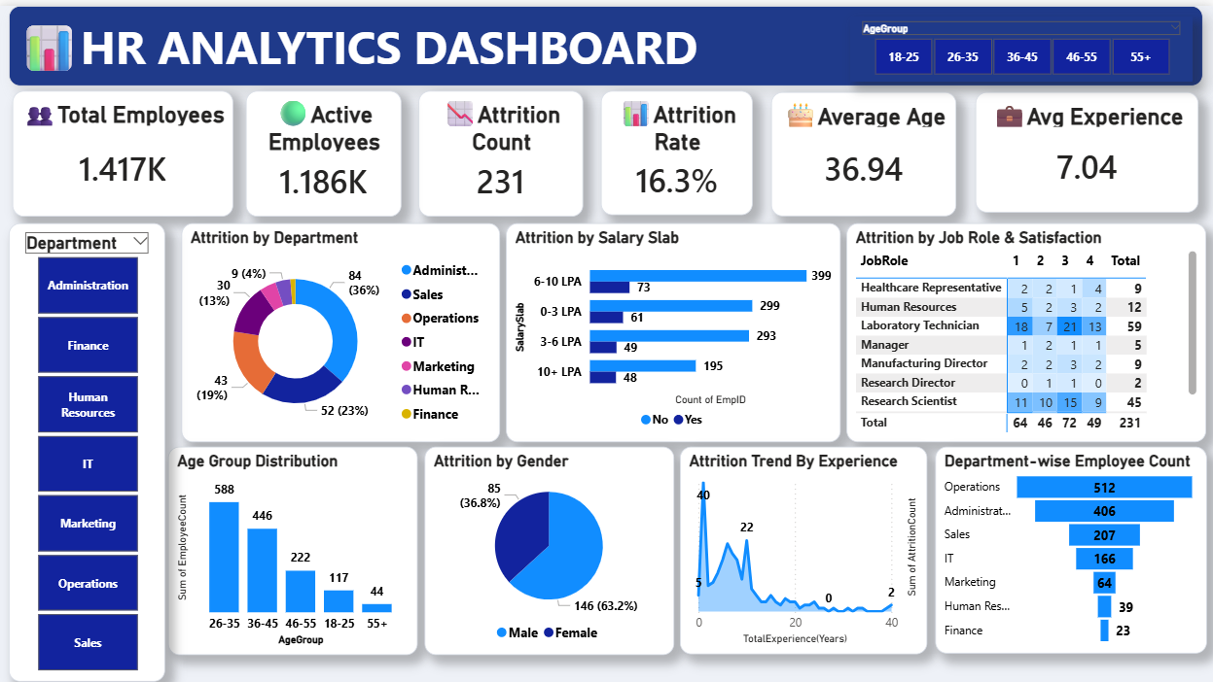
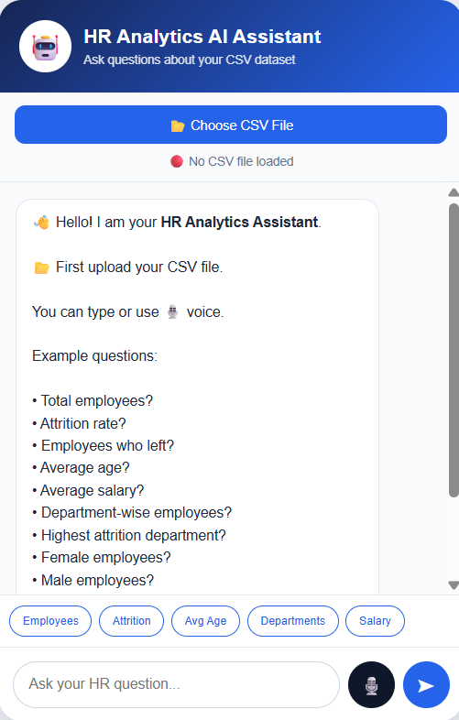


Block Diagram
Data Collection
Data Cleaning
Data insert & add
Final Dashboard
Final Ai Assistant
For HTML Code
For Popper Output

Slide 9

Expected Result
Expected output of the project

Slide 10
Work – Plan
Months Activities | JULY’26 | AUG’26 | SEPT’26
Finding Dataset | ☑️
Data Cleaning |  | ☑️
Data Insert & Add |  | ☑️
Dashboard Creation using KPIs |  | ☑️ | ☑️
Colouring |  |  | ☑️
Design |  |  | ☑️
Built AI Assistant Using ChatGPT & VS Code |  |  | ☑️
Final Testing on Creating System |  | ☑️ | ☑️

Slide 11
References
For Dashboard
1. Data Collection
Using:- Kaggle.com
‘Collection of Employees Dataset in .csv format.’’
2. Data Cleaning
Using:- Excel
‘We cleaned the data by checking missing values, removing duplicate, correcting wrong data, fixing spelling, removing unwanted data, and correcting data types.’
3. Data insert & add
Using:- Power BI Get Data
‘We load the complete cleaned data into Power BI Desktop.‘

Slide 12
References
4. Final Dashboard
Using:- Power BI Desktop
We created a good dashboard with useful KPI cards that help HR analyse employee data easily.

Slide 13
References
For AI Assistant
1. For HTML Code
Using:- ChatGPT
We used ChatGPT to get help in Writing the HTML and JavaScript code for the AI Assistant.
2. For Proper Output Interface
Using:- Vs Code
We used VS Code to build a proper AI Assistant and Create a user-friendly interface.

Slide 14
Thank you !
Nagpur | Pune | Jalgaon | Amravati | Pandhurna | Bhandara

